Slide 1
WorldVisitz Mobile Application Agile Delivery Launch
Agile Foundations - Presentation for the Leadership Team
Presented by: Shaikat Majumder
© 2019 Udacity. All rights reserved.

Slide 2
Part 1: How WorldVisitz Can Benefit From Agile

Slide 3
What is Agile?
include a description of the Agile Manifesto and why it is important to follow it
The Agile methodology is a project management approach that involves breaking the project into phases and emphasizes continuous collaboration and improvement. Teams follow a cycle of planning, executing, and evaluating.
https://www.atlassian.com/agile
Notes:
Agile is an important development methodology that allows for teams to build products faster than ever before. It is a project management approach that is new and as opposed to the waterfall model is extremely adaptable to changing requirements allowing diverse teams across the world to adopt it.

Slide 4
Why Agile is Important
Why we care about Agile
Agile Allows for Swift and Incremental Delivery of the Project allowing for the most adequate and market fit solution,
Agile is Minimal and extremely adaptive to the requirements of the project and the team allowing for maximum flexibility to ensure high quality teams
Agile allows for the maximum learning in an incremental way, so we do not have to wait till after the launch to learn about our product’s performance
Notes:
Agile is extremely fluid as compared to the older waterfall models. Since most of the projects in the current times have a high changin requirement, hence the use and popularity of the agile framework is extremely relevant in the recent times. Agile is extremely useful for the project that is taken on my WorldVisitz as the project has a tight time to launch in the market and there are several changing requirements. Therefore it is obvious that a lot of learning is required by the entire team to lead this product and the development must be done in small incremental steps to avoid big blunders.

Slide 5
What is Agile Manifesto?
The 12 Principles of the Agile manifesto:
Our highest priority is to satisfy the customer through early and continuous delivery of valuable software.
Welcome changing requirements, even late in development. Agile processes harness change for the customer's competitive advantage.
Deliver working software frequently, from a couple of weeks to a couple of months, with a preference to the shorter timescale.
Business people and developers must work together daily throughout the project.
Build projects around motivated individuals.Give them the environment and support they need, and trust them to get the job done.
The most efficient and effective method of conveying information to and within a development team is face-to-face conversation.
Working software is the primary measure of progress.
Agile processes promote sustainable development. The sponsors, developers, and users should be able to maintain a constant pace indefinitely.
Continuous attention to technical excellence and good design enhances agility.
Simplicity → the art of maximizing the amount of work not done--is essential.
The best architectures, requirements, and designs emerge from self-organizing teams.
At regular intervals, the team reflects on how to become more effective, then tunes and adjusts its behavior accordingly.
Notes:
The agile manifesto has 12 principles and 4 values that were crafted to allow for minimal ambiguity in the teams that are going to adopt the agile approach. The principles of agile allow for the values of the agile to be implemented in teams efficiently.

Slide 6
Reasons for the Agile Manifesto
Why do we want to follow the Agile Manifesto?
The Agile Manifesto exactly and precisely sets out the 12 principles and 4 values to makes the offerings of the agile exactly and unambiguous
The Agile Manifesto is focused on responding to change over following comprehensive documentation
Focuses on customer collaboration over contract negotiation
Responding to change over following a Plan
Individuals and Interactions over Processes and Tools
Notes:
The values of agile are the ones that are responsible for the development of the 12 agile principles. The follow the agile manifesto as it provides us with the 4 important values that allow for a output driven or outcome driven approach rather than being stuck in a process and tool based approach that take away time and energy in just following the methods.

Slide 7
Key differences between Agile and Waterfall
List the key differences between the two of them
Agile
Waterfall
Follows a iterative and incremental model of Development
More flexible and adaptable to changing requirements
Incremental, small deliverables, lightweight documents
Follows a Linear Sequential Model of Development
Less Flexible and Adaptable to changing requirements
Comprehensive documentation and delivery of project done at once at the end
Notes:
Waterfall has been very rigid and hence for the needs of the changing requirements for the softwares of the modern times it was important for the development of the agile methods.

Slide 8
The benefits of Business Agility to WorldVisitz
Your argument should explain: (i) why Agile is a more effective solution for WorldVisitz, and (ii) incorporate at least two Agile principles
Principle of Agile that helps WorldVisitz: Individuals and Interactions over Processes and Tools
How Agile Become a More Effective Solution: Allows for the Development of Software that is made via keeping the individuals and customers in focus to allow for the most appropriate software rather than over focusing on tools
Principle of Agile that helps WorldVisitz: Responding to Change over following a Plan
How Agile Become a More Effective Solution: Allows for the development of software that is built incrementally to allow for the development of a product that is market fit and solve the problem in the product in an incremental approach while fostering standards, knowledge transfer and Standards
Notes:
Agile will definitely be of immense help to the WorldVisitz project as will allow for the development of the right product that will be market fit. Further agile will help in launching the product in small incremental approach and any mistakes or shortcoming can be thoroughly analysed by the team in sprints and changes can be accommodate aoccordingly.

Slide 9
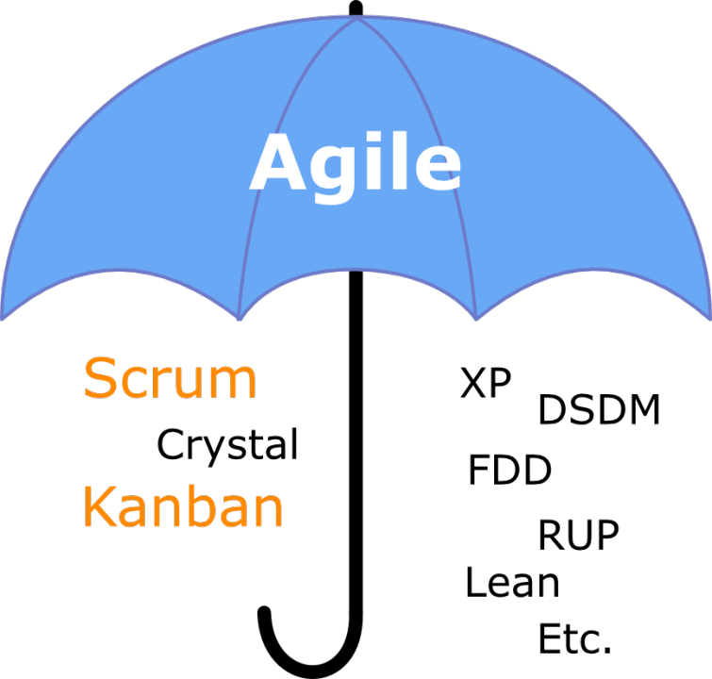
What is Agile Umbrella
include a comparison of each of the three frameworks (Scrum, Kanban, XP)
The Agile Umbrella:
The beauty of Agile lies in its versatility and its ability to accommodate diverse frameworks. Some of the most popular Agile frameworks include Scrum, Kanban, Lean, Extreme Programming (XP), and many others. These frameworks offer distinct approaches to Agile implementation, tailored to meet specific organizational needs and objectives.
Notes:
Agile is a general broad term. There are several exact frameworks that agile follows like scrum, kanban and XP to name a few and most popular ones. These frameworks have several things in common, they all have several ceremonies and different types of roles. Scrum and kanban is focused on any type of product building while the XPframework is more suited towards software development specifically.

Slide 10
The Agile Frameworks
Scrum | Kanban | XP
The length of each sprint is fixed and no or minimal changes during the sprint | Changes can be accommodate any time | Changes are made at all levels, framework is reviewed and adjusted every sprint.
Work is organised in fixed length iteration called sprints | Work is organised and visualised using boards called Kanban Boards. Members pull work from the backlog only when there is room for work (WIP) system where the items move from left to right | Work is organised is short iterations
Roles are Product Owner, Scrum Master and the Agile Team | Roles are Product Owner, Facilitator and the Agile Team | Roles are Customer, Tester, Coach and Programmer

Slide 11
Part 2: The Optimal Agile Framework for WorldVisitz

Slide 12
Challenges to the Business of WordlVisitz
Streaming Development Time and Faster Delivery (less than 18 months)
Foster Knowledge transfer between the team members
Build Trusts and Standards in the Team
Build Incrementally, Well-tested and Market-fit Product
Improve the team efficiency by addressing skill gaps, weaknesses and anti-patterns
Notes:
There ar several challenges to the business. It is important to be able to build the right product under a reasonable time while making sure that the coding standards are high. However the existing team has several weaknesses, skill gaps and anti patterns that needs to be fixed in order to allow for a high performing agile team that is able to handle the task at hand.

Slide 13
Majors Concerns for the Leadership
Current Lack of Knowledge Transfer
Lack of Trust and Camaraderie among Developers
Notes:
The leadership has specific concerns which are well justified. A lack of knowledge transfer will create a lot of friction in onboarding additional developed and create unnecessary bottlenecks and point of dependencies that can put the project at risk. Hence it is very important to allow for knowledge transfer which can only occur in an environment that foster trust and team collaboration.

Slide 14
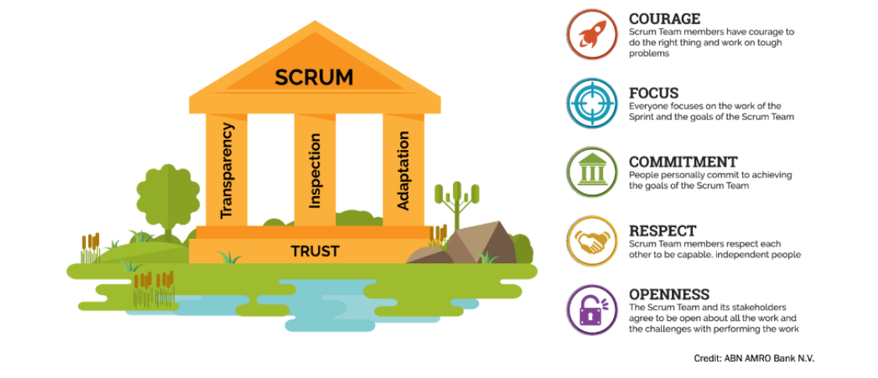
The Recommended Framework
What I suggest should be used for WorldVisitz
Scrum Framework
https://www.scrum.org/resources/what-scrum-module

Slide 15
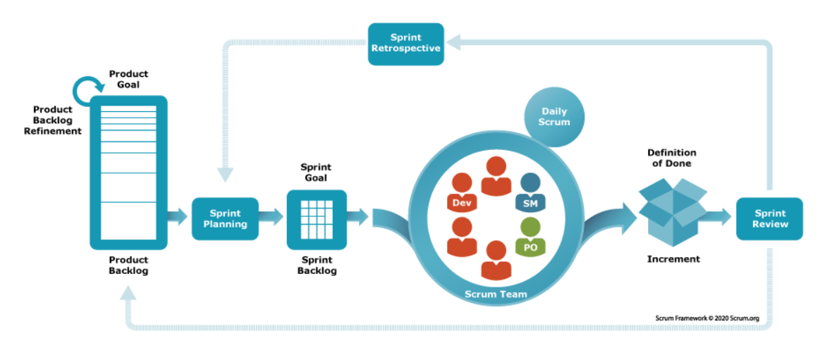
Recommended Framework Structure
Scrum Framework Ceremony, Structure, Agenda, Frequency, Duration and Purpose

Slide 16
The Scrum Framework Structure
Event Name | Agenda | Frequency | Duration | Purpose
Sprint Planning | The Scrum Master facilitates this meeting to select items from the backlog for the upcoming sprint according to the team capacity | At the beginning of each sprint | 8 hours for a 30 day sprint | Planning the upcoming sprint
Daily Scrum | Team members to update the team about their tasks and team to remove any blockers as identified by the team | Held Daily or Everyday | 15 minutes daily | Updating the team on daily works
Sprint Review | Presentation of work completed during the sprint, reviewed against the product goal and feedbacks given by the stakeholders | Held at the end of every sprint | 4 Hours for a 30 day sprint | Reviewing the work done by stakeholders
Sprint Retrospective | Reflection of previous sprint, prioritise opportunities for improvements and create new items for backlog for next sprint | Held after the sprint review and before the next sprint | 3 hours for a 30 day sprint | Finding opportunities to improve
Backlog Refinement | Team to review backlog items for making sure the backlog items are well defined, understood by the team and ready for sprint planning sessions. | Conducted as per requirements | Around 3 days for a 30 day lng sprint | Improving the backlog for next sprints

Slide 17
How Recommended Framework can be used to Solve the Challenges
Scrum Provides Well Planned Approach Sprinting Planning ensuring that the sprint work in done with minimal confusion and proper division of workings
Scrum ensures that the product is built incrementally according to the Market requirements by breaking down the whole development process into 14 day long sprint
Scrum allows for knowledge transfer and standardised review cycles to better understand what should be improved to allow for even more efficient development in the upcoming sprints

Slide 18
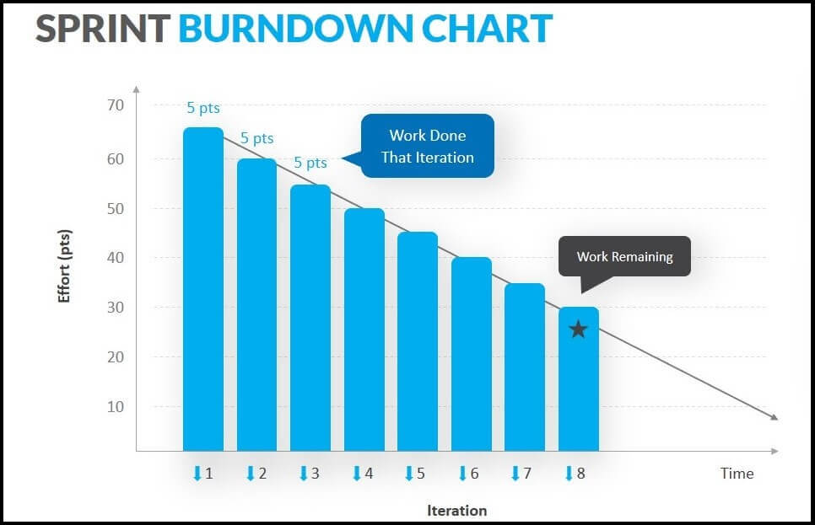
Information Radiator for Scrum
Suggested 2 Information Radiators
Information Radiator 01: Burndown Chart:
A burndown chart shows the amount of work that has been completed in an epic or sprint, and the total work remaining.
Benefit of the Information Radiator
Helps in understanding the probability of the work being completed,
Keeps the team in track on the sprint by visualizing the effective down being done
https://www.google.com/url?sa=i&url=https%3A%2F%2Funichrone.com%2Fblog%2Fagile%2Fsprint-burndown-chart%2F&psig=AOvVaw0fOg3YJmdqij0VN9MGqAyQ&ust=1713889859040000&source=images&cd=vfe&opi=89978449&ved=0CBIQjRxqFwoTCJCh_7Of1oUDFQAAAAAdAAAAABAE
Notes:
Burndown Chart is an extremely good information radiator for the team to stay aligned on the amount of work that they are currently ruminating with. This is to motivate the team and see if they can complete the tasks assigned in the given time. Also this helps immensely in the upcoming sprint planning.

Slide 19
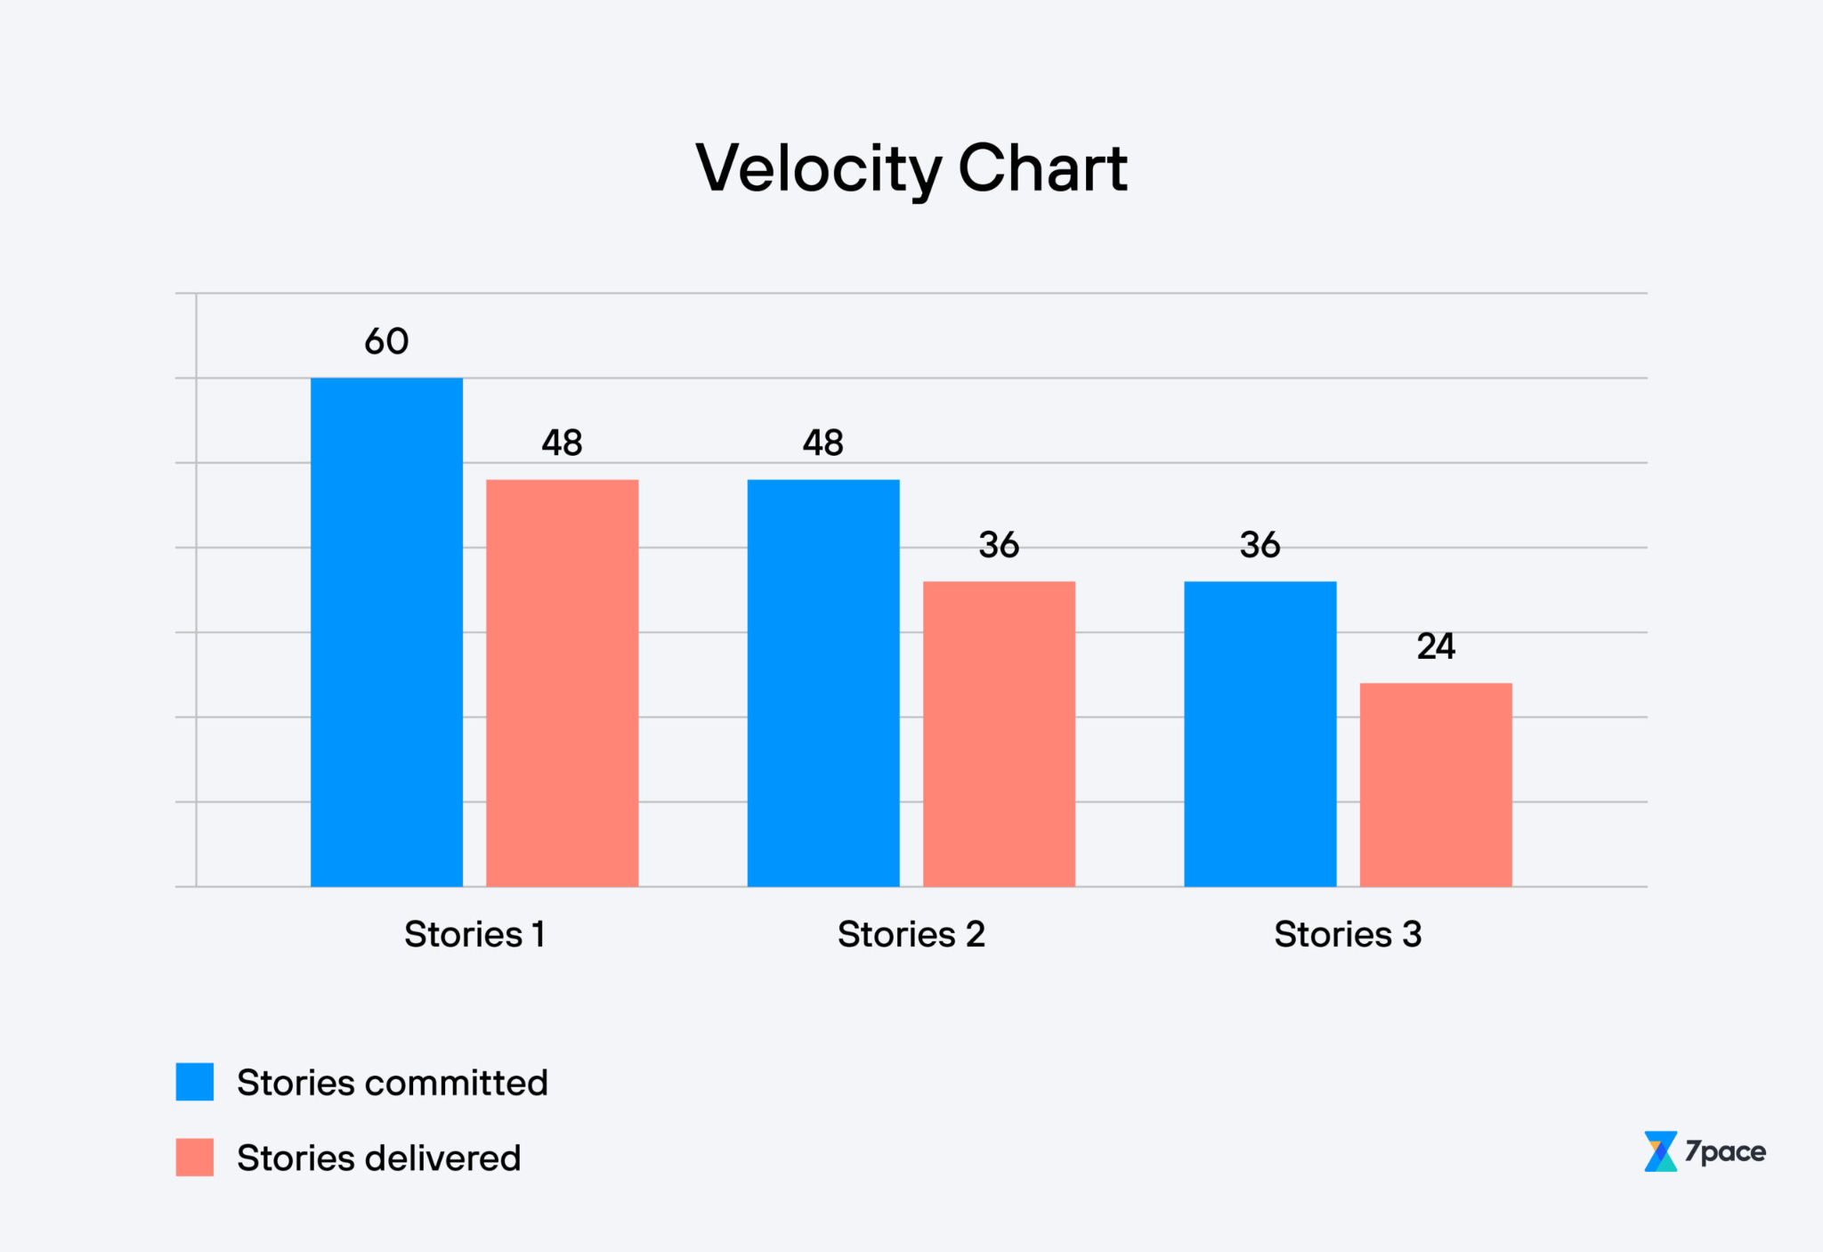
Information Radiator for Scrum
Information Radiator 02: Velocity Chart
It is an overview of how much has been delivered each sprint
Benefit of the Information Radiator
Can be used as a suitable indicator to find out team burnout
Helps in understanding the teams capacity and capabilities and helps in better allocating work for the upcoming sprints
Notes:
Velocity Charts are extremely important as they help identify the efficiency of the team while at the same time giving us a reference to compare the team performance month on month. Any burn downs in the team or friction can be directly linked to changes in the velocity and be identified earlier and necessary steps can be taken.

Slide 20
Thank You

